Slide 1
Final Project - Part 1: Lightning Talk
Yee Lam (Ellein) Cheng

Slide 2
Project Idea 1: Gun Sales & Shootings

Slide 3
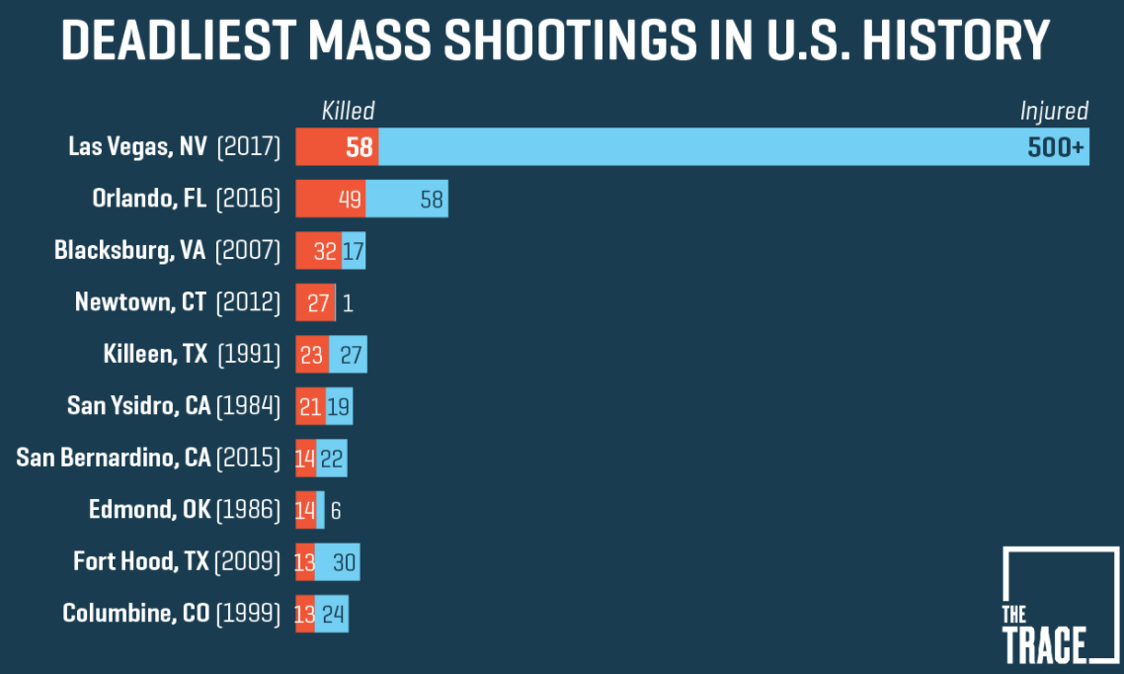
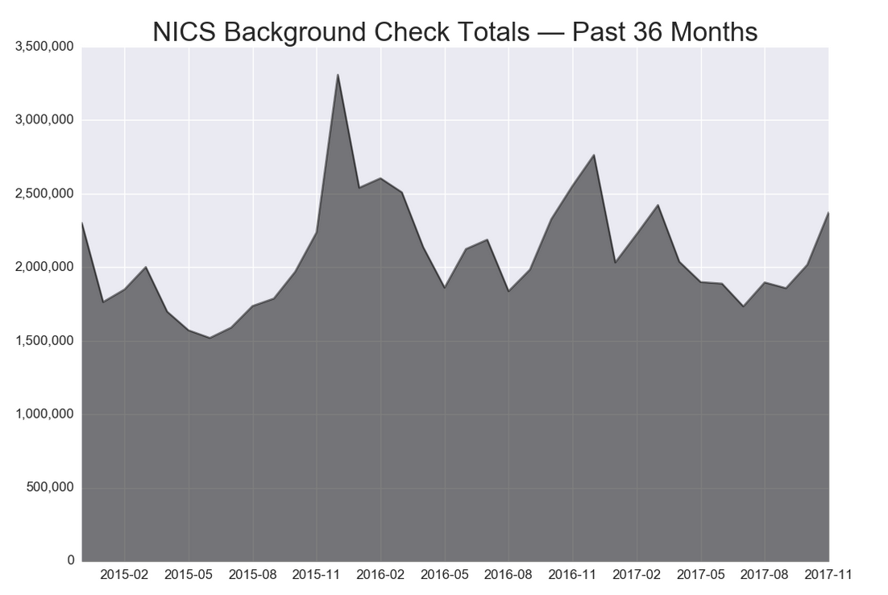
Gun Sales & Shootings
The Problem:
Shootings in the United States have become a common occurrence in the last few years. Gun sales are believed to be increasing overall, and also to spike in the immediate aftermath of a mass shooting.
The Data:
Dataset 1: Number of Firearm Checks by Month, State, and Type
Source: FBI’s National Instant Criminal Background Check System (NICS)
Timeframe: November 1998 – November 2017
Dataset 2: US Mass Shootings Data
Source: Mother Jones’ Investigation
Timeframe: 1982 - 2017
Hypotheses:
Predicting frequency of and severity of shootings by state based on firearm checks and projected gun sales.
Notes:
Latest Mass Shootings Incidences:
Las Vegas Strip Massacre (10/1/2017 – 540+ victims – 58 fatalities)
Fort Lauderdale airport shooting (1/6/17 – 11+ victims – 5 fatalities)
Orlando Nightclub Massacre (6/12/2016 – 100+ victims – 49 fatalities)
Data:
Number of Firearm Checks by Month, State, and Type
https://github.com/BuzzFeedNews/nics-firearm-background-checks
Types include Permit, Prepawn, Redemption, Rentals, Private Sale, Return to Seller
Handgun, long gun, other
US Mass Shootingss:
http://www.motherjones.com/politics/2012/12/mass-shootings-mother-jones-full-data/#
Background: where, when, what
Fatalities, Injured, Total Victims
Mental health, weapon types/sources
93 data entries

Slide 4
Project Idea 2: Human Trafficking

Slide 5
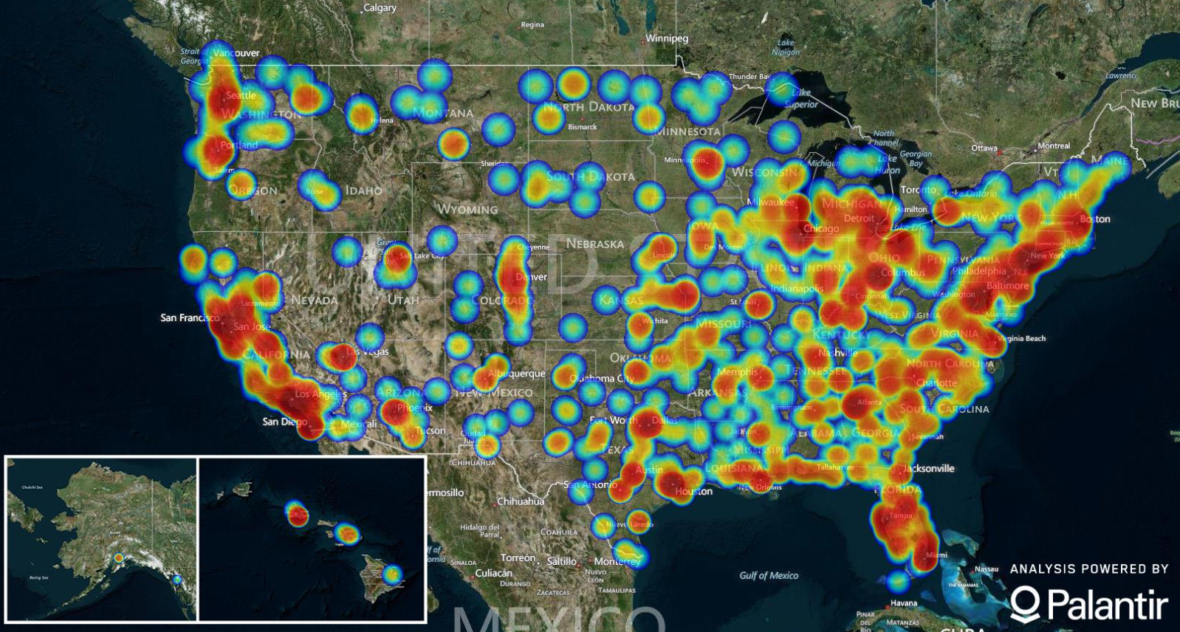
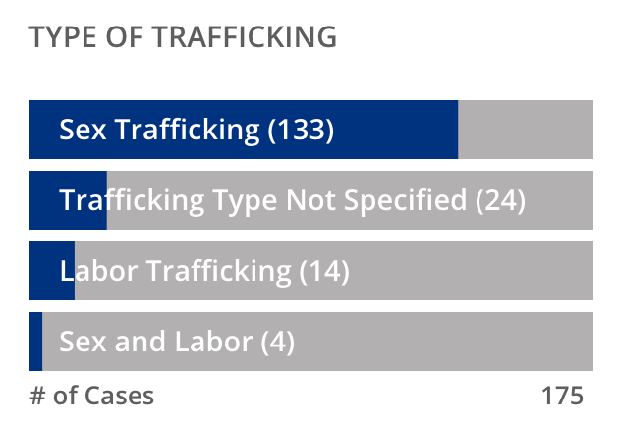
Human Trafficking
The Problem:
Human trafficking has become a severe global battle that is challenging to fight. According to a September 2017 report from International Labor Organization, an estimated of 25mm victims are trapped in modern–day slavery.
(2016 – potential trafficking cases)
The Data:
Challenging to acquire due to the sensitivity of data
Potential sources:
Polaris Project – Hotline Statistics (2013-2017)
Restore NYC – data on resource allocation to help connect survivors of sex trafficking in NY to safe, sustaining jobs
UN Data – Victims of human trafficking by time period, gender, age, reference area
Data.gov:
Finding Victims of Human Trafficking, 2005-2008
Estimating Human Trafficking into the United States [Phase I: Development of a Methodology] - 8 countries in South America
(2016 – Hotline Stats)
Hypotheses: (Might vary depending on data available)
Determine the relationship between the allocation of resources vs success in: a) identifying victims, b) survivor empowerment.
Notes:
Map of potential trafficking cases in the US.
Type of Trafficking – 2016 – Hotline Statistics
The National Human Trafficking Hotline maintains one of the most extensive data sets on the issue of human trafficking in the United States.
The statistics contained on this website are based on aggregated information learned through signals -- phone calls, emails, and online tip reports -- received by the Hotline.
The National Hotline uses this data to help human trafficking victims and survivors and to provide the anti-trafficking field with information to help combat all forms of human trafficking.
https://polarisproject.org/befree-textline/stats
https://humantraffickinghotline.org/states
UN Data:
http://data.un.org/Data.aspx?q=human+trafficking&d=SDGs&f=series%3aVC_VAW_HMTRAF
Data.gov:
https://catalog.data.gov/dataset/finding-victims-of-human-trafficking-2005-2008
https://catalog.data.gov/dataset/estimating-human-trafficking-into-the-united-states-phase-i-development-of-a-methodology-02185

Slide 6
Project Idea 3: Star wars survey

Slide 7


Star Wars survey
The Problem:
The prequels of the Star Wars series (Episodes I-III) are widely believed to be poorly produced. As a member of the Lucasfilm staff, how do we maximize the chance of success for the newest trilogy.
The Data:
Source: FiveThirtyEight
A poll ran through SurveyMonkey Audience, surveying 1,186 respondents
Timeframe: June 3-6, 2014
Includes gender, age, self fan categorization, movies watched, movie rankings, favorability of characters, familiarity with Expanded Universe/Star Trek, ...
Hypotheses:
Determine the driving ‘FORCE’ of a Star Wars movie’s popularity based on its various attributes
Notes:
https://github.com/fivethirtyeight/data/tree/master/star-wars-survey
https://brorlandi.github.io/StarWarsIntroCreator/#!/AL08IWlCdOdCknB_O2zl

Slide 8
Q & A

